Slide 1

AGI Spinning System Overview
Last Update Date 15-Jan-2024

Slide 2
Overview
The presentation provides an overview of AGI Denim yarn production process, specifically focusing on the Spinning Division, which operates as part of the AGI group.
The Spinning Division is responsible for producing Finish Yarn for the internal denim units, which is treated as a separate operating and inventory unit within the system.
The key point highlighted is the dispatch of yarn from the Spinning Unit to Denim Mill 1 and Denim Mill 2, emphasizing the integrated and internal nature of this yarn supply chain.

Slide 3
Overview
Following are major processes of AGI Spinning Mill:
Purchase Order is shared by AGI Denim Mill.
Sales Order is created automatically by entering the Denim Mill’s PO Number.
Spinning Mill maintains cotton inventory season wise.
Production planning is performed using Oracle EBS.
Production is entered by using workorder less entry.
Yarn produced is dispatched using standard Oracle EBS procedure.

Slide 4
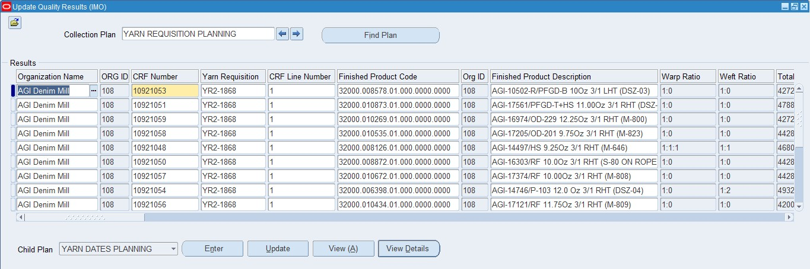
Overview (Cont’d)
Responsibility Name : DM1 Production Planning
Form Name : Yarn Requisition
Yarn Demand/ Requisition & Purchase Order
Yarn demand / requisition will be raised by procurement department on the basis of yarn requisition planning raised by planning department.
Yarn Requisition Plannings

Slide 5
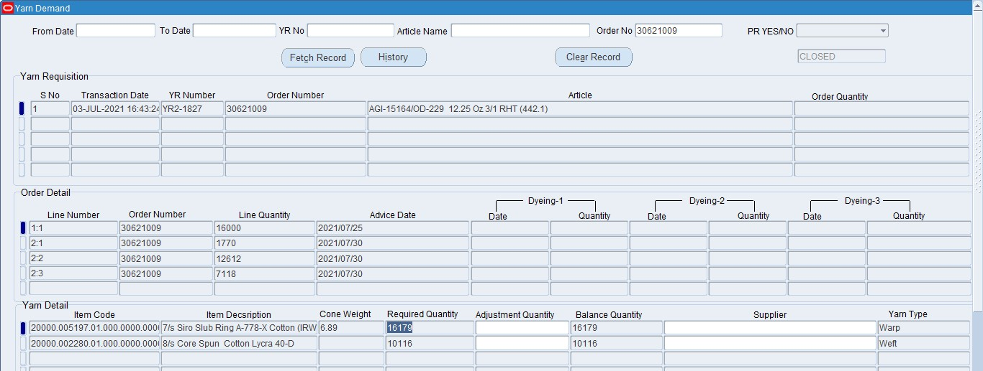
Responsibility Name : DM1 Production Planning Form Name : Yarn Demand User finds an order whose YR(Yarn requirement generated by planning department).

Slide 6
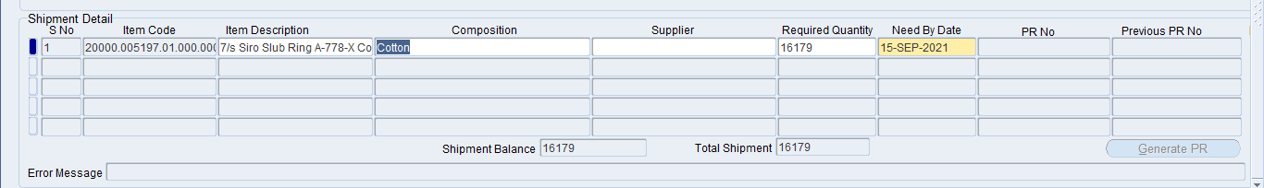
Responsibility Name : DM1 Production Planning Form Name : Yarn Demand Shipment Detail In Shipment Details user can break 1 shipment into multiple lines based on Supplier and Need By Date. Finally Purchase Requisition is generated after pressing Generate PR Button.

Slide 7
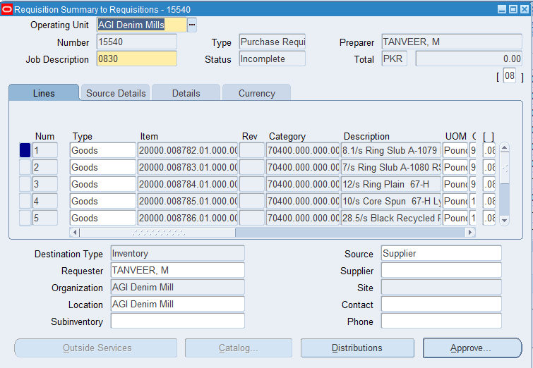
Responsibility Name : DM1 Purchase Requisition Form Name : Purchase Requisitions Yarn Purchase Requisition

Slide 8
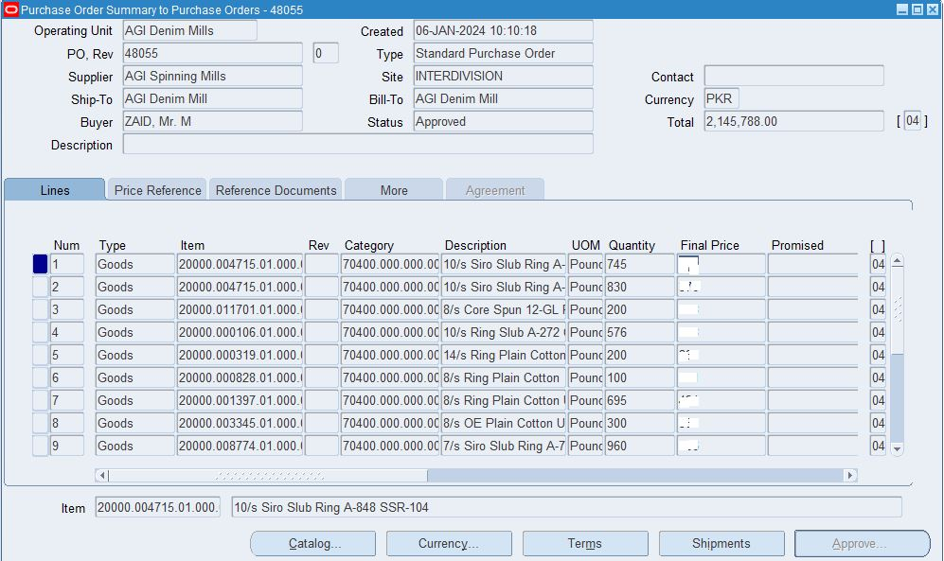
Responsibility Name : Yarn Purchasing PO Prepare Form Name : Purchase Order Once requisition is approved, Purchase order will be generated by using Auto Create Functionality

Slide 9
Yarn Costing Calculator
Overview
Yarn costing calculator is developed by IT department after gathering the requirements from Jamal Sb, Arman Sb and Asher Jameel
It will help us to easily drive yarn cost from the system and also replace the huge excel working.
Due to large size of data the excel file was taking over 10 mins to open
Components
Following are the basic components of Yarn Costing Calculator:
OPS Detail Entry Form
For each yarn OPS will be maintained in EBS.
Overhead Entry Form
Overhead will also be maintained in EBS.
Cotton / Fiber Rates For
For the costing purpose additionally, rates will be maintained in the system.
Costing Calculator
Yarn System will calculate Yarn value per LBS.
Yarn Costing Reports
These reports will display the costing details.

Slide 10
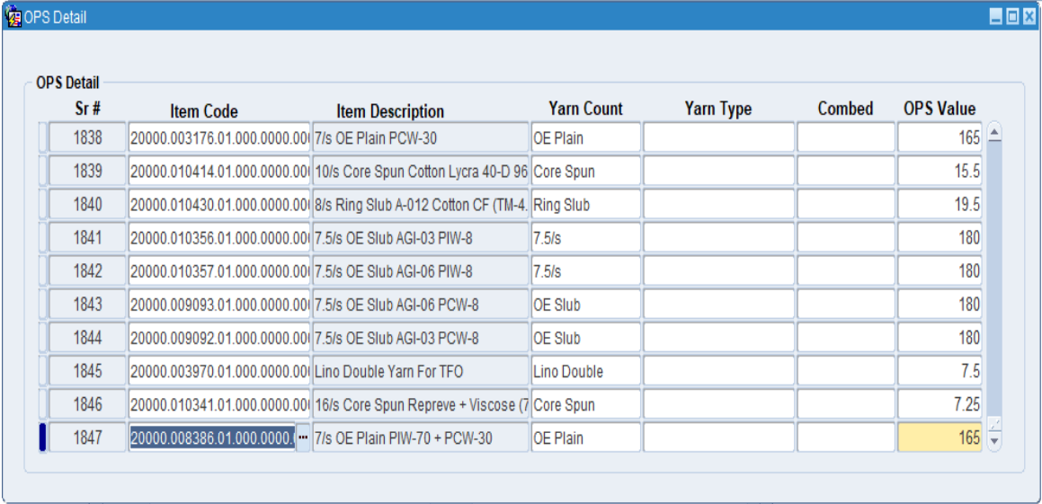
Responsibility Name : ASD OPS Detail Form Name : ASD OPS Detail

Slide 11
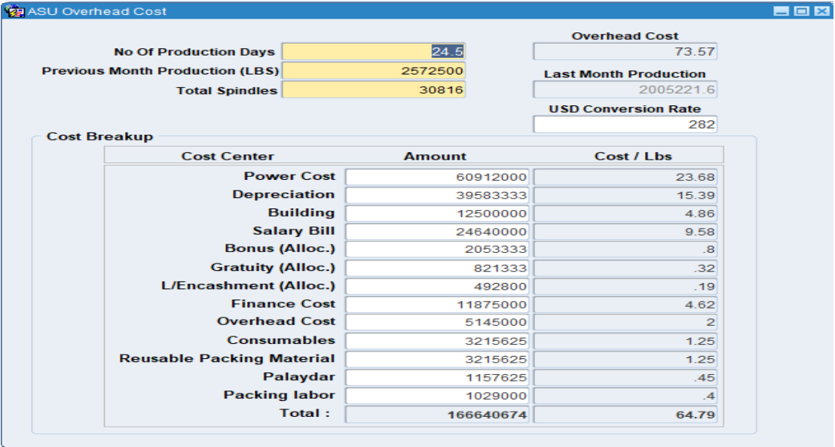
Responsibility Name : ASD Yarn Costing Form Name : ASD Over Head Cost

Slide 12
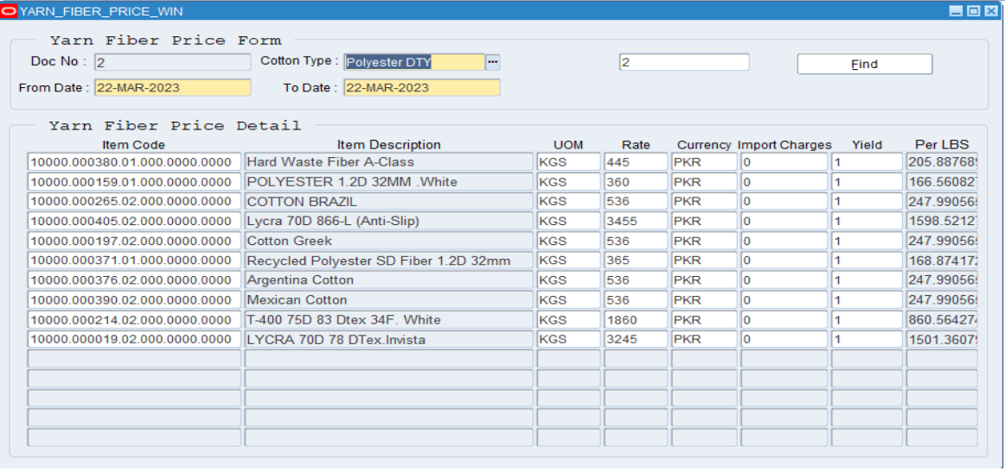
Responsibility Name : ASD Yarn Costing Form Name : ASD Yarn & Fiber Rate Form

Slide 13
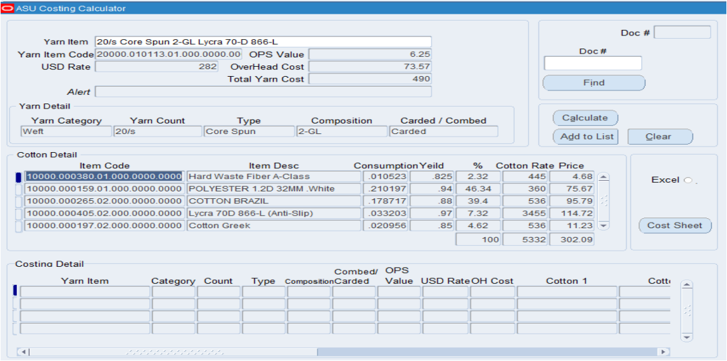
Responsibility Name : ASD Yarn Costing Form Name : ASD Yarn Costing

Slide 14
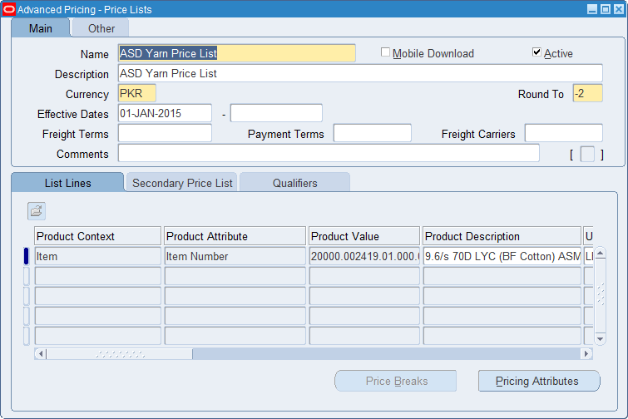
Responsibility Name : ASD Yarn Pricing Form Name : Price List Setup A separate pricing list has been established by the Spinning Mill specifically for yarn. This pricing information is subsequently updated in the purchase orders generated by the Denim Unit for the Spinning Division. This ensures that the procurement transactions between the Denim Unit and the Spinning Division accurately reflect the agreed-upon yarn prices established by the Spinning Mill’s

Slide 15
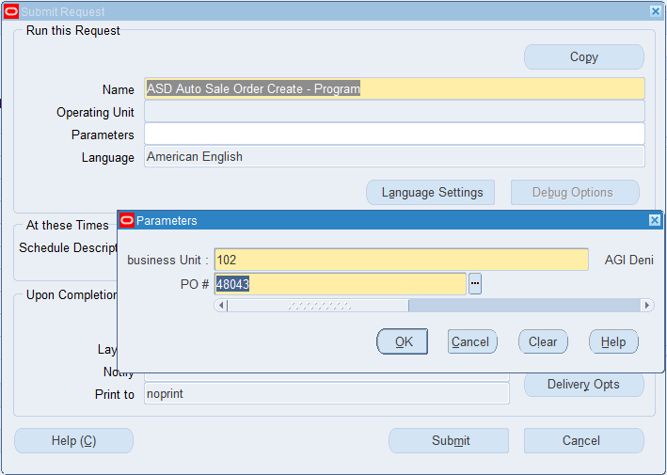
Sale Order Responsibility Name : ASD Order Management Super User Spinning division will run following program to auto-generate Sale order received from Denim Mill so user just need to book the created order after reviewing it.

Slide 16
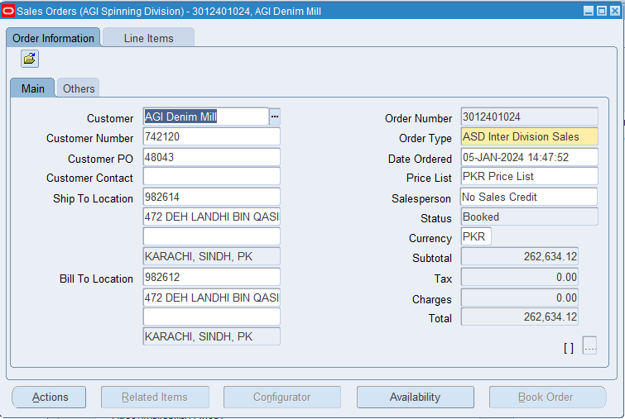
Responsibility Name : ASD Order Management Super User Form Name : Sale Order Sale Order Header

Slide 17
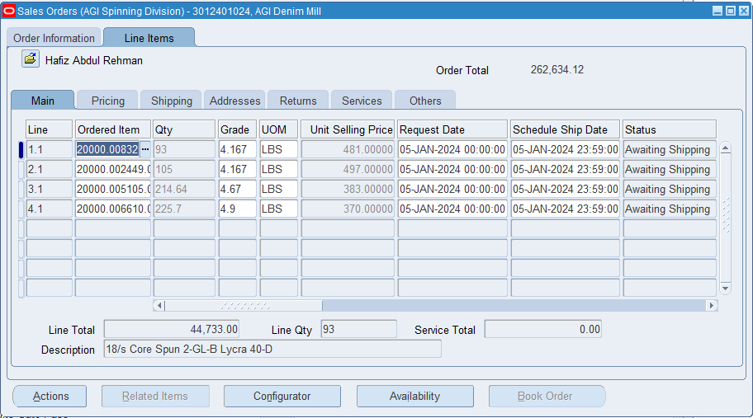
Responsibility Name : ASD Order Management Super User Form Name : Sale Order Sale Order Lines

Slide 18
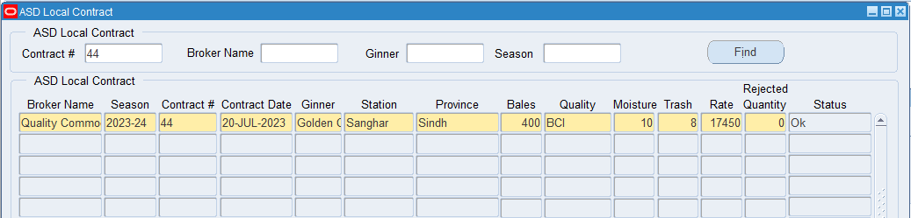
Responsibility Name : ASD Cotton Contract Form Name: ASD Local Contract Procurement of Raw Material – (Spinning Division) Contracts Separate forms are available for local and import cotton contracts ASD Local Contract

Slide 19
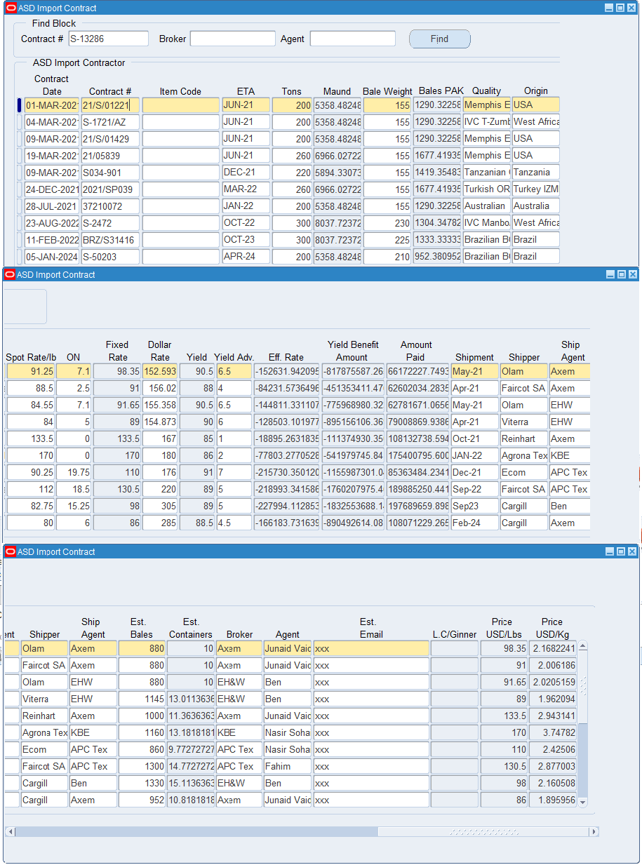
Responsibility Name : ASD Cotton Contract Form Name : ASD Import Contract

Slide 20
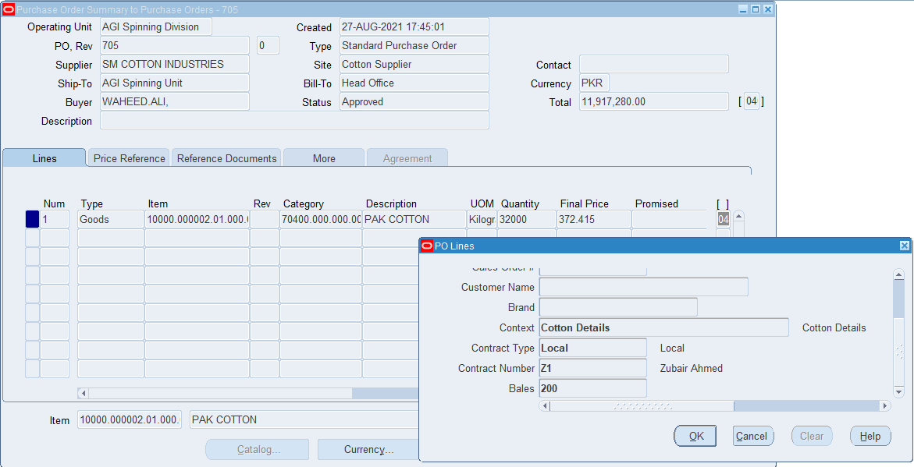
Responsibility Name : ASD Cotton Purchasing PO Preparer Form Name : Purchase Order Fiber items are procured by spinning by using standard purchase order form. Contract detail for cotton items will be mandatory.

Slide 21
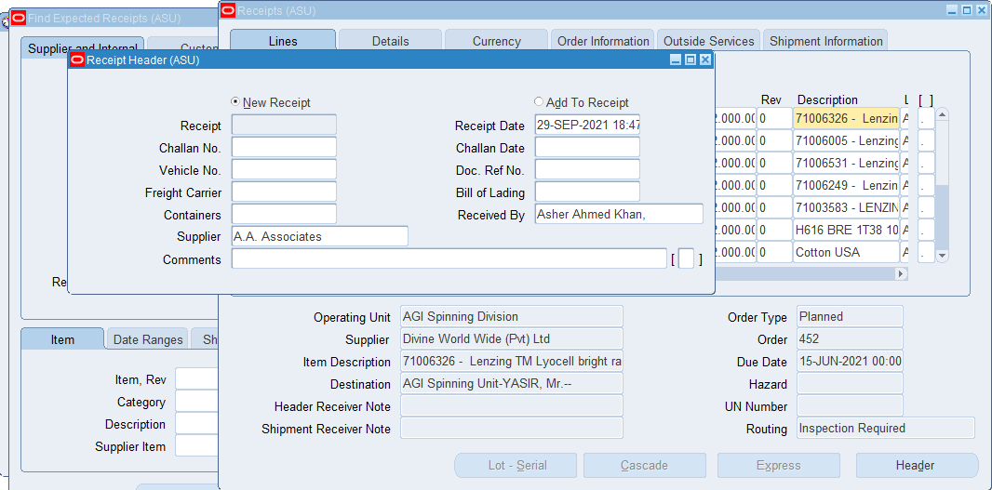
Responsibility Name : ASD Inventory Team Member Form Name : Receiving Transaction Fiber items are controls via below category segments in system.
Category Segment | Description | Meaning
Major | Item prefix | Fibers
Minor | Fiber Type | Cotton / Other Fibers
Sub | Fiber Category | Cotton / Poly / Lycra etc.
System will check contract, bales and lot attributes for fiber items whose minor category is marked as "COTTON".
Receiving of Raw Material
Standard GRN form will be used to record receiving of fiber items

Slide 22
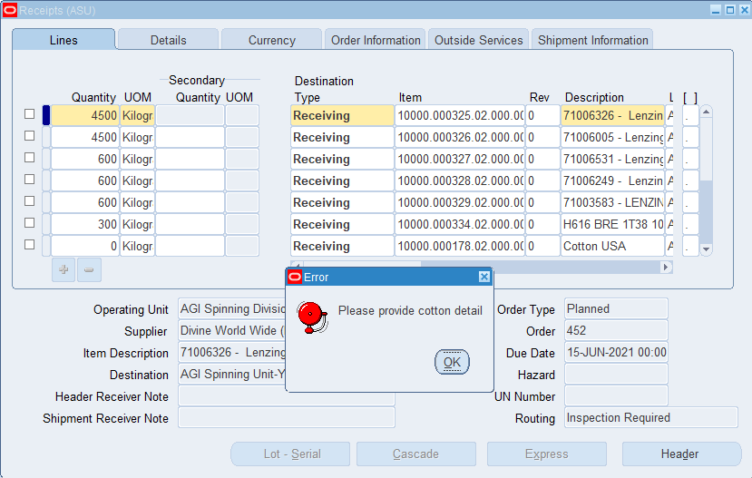
Responsibility Name : ASD Inventory Team Member Form Name : Receiving Transaction For Cotton items whose minor category is classified as Cotton, system will ask user to provide cotton details.

Slide 23
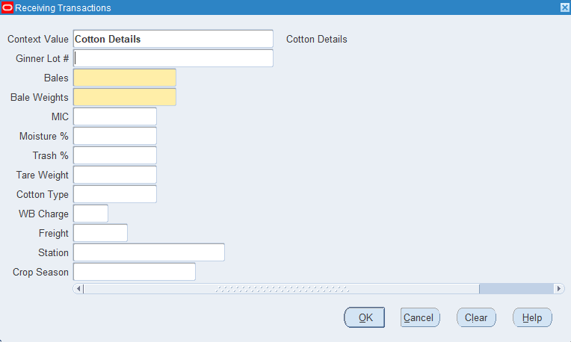
Responsibility Name : ASD Inventory Team Member Form Name : Receiving Transaction User will provide cotton detail in context value. Here GRN quantity in KGS will be auto-calculated on the basis of moisture, trash and tare weight as per the predetermined formula. Bales and bale weight will be mandatory for both local and import cotton, whereas Ginner Lot #, Invoice Weight, Moisture %, Trash % and Tare Weight will be mandatory for local cotton only.

Slide 24
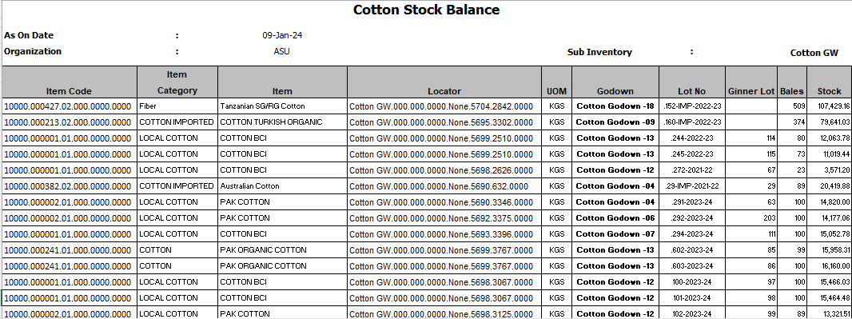
Cotton Stock Report Report Name : Inventory Cotton Stock Balance - AGI (Denim)- Report

Slide 25
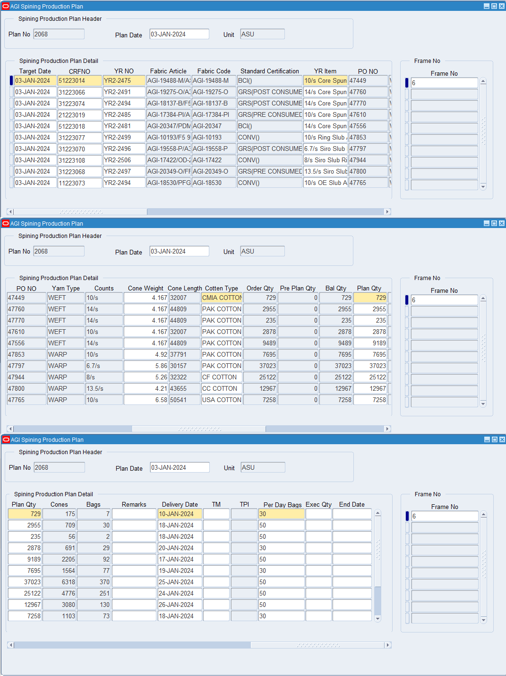
Responsibility Name : ASD Production Plan Form Name AGI Spinning Production Plan

Slide 26
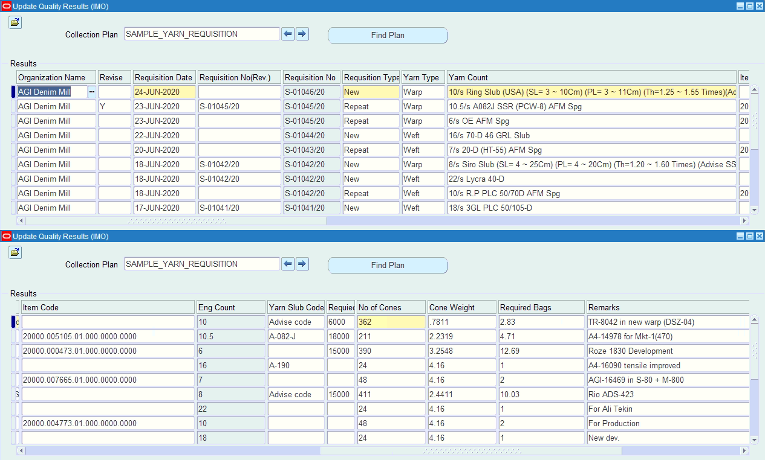
Sample Yarn Requisition Separate plan is generated for sample production generated by planning department. It contains complete yarn information along with sample type (i.e. New, Repeat)

Slide 27
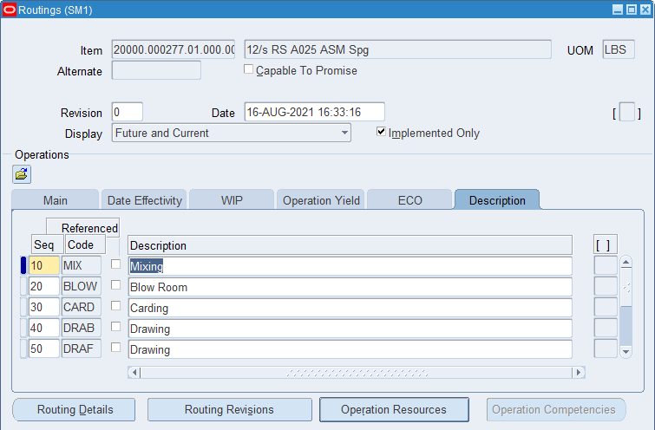
Responsibility Name : ASD Bill Of Material Form Name : Routings Routing and BOM Oracle discrete Manufacturing provides functionality to set standard routing and Bill of Material of finished items. Routing Routing represents the processing sequence in the manufacturing operations. All labor and other overhead cost pertaining to an item are defined at routing. Following form is available to create routing in EBS.

Slide 28
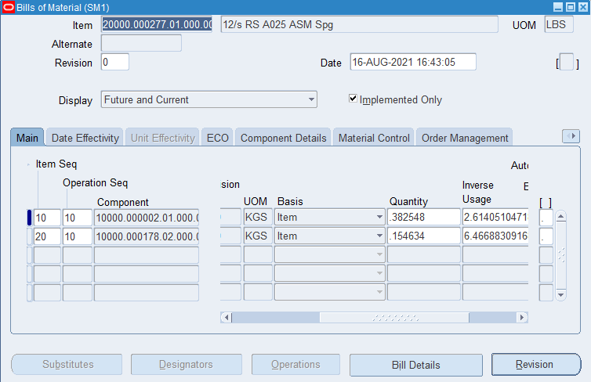
Responsibility Name : ASD Bill Of Material Form Name : Bill of Material Bill of Material (BOM) is a list of components required to manufacture its parent (assembly) item. To manufacture a yarn, fibers are its major component. On the basis yarn count and other attributes the recipe is defined in following form.

Slide 29
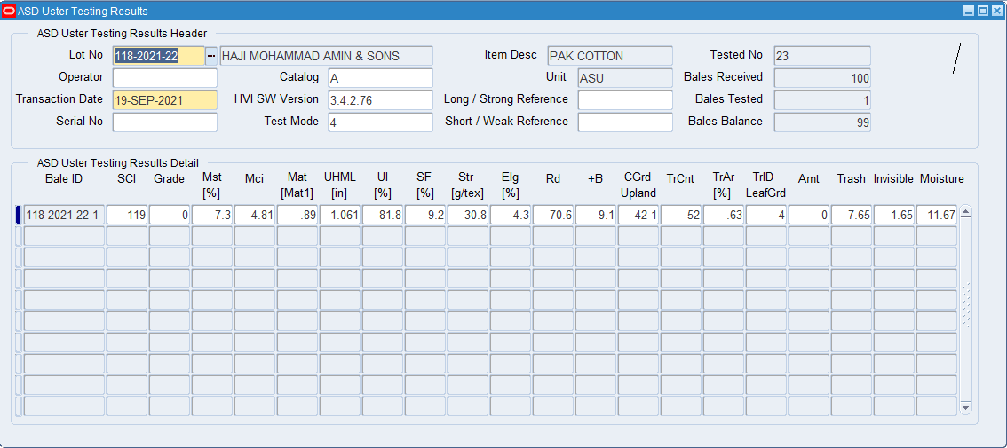
Responsibility Name : ASD Uster Testing Results Form Name : ASD Uster Testing Results Maintaining Test Results for Bales Cotton and other fibers are tested before issuance at production fibers. For Cotton testing following from has been developed to record testing results in system.

Slide 30
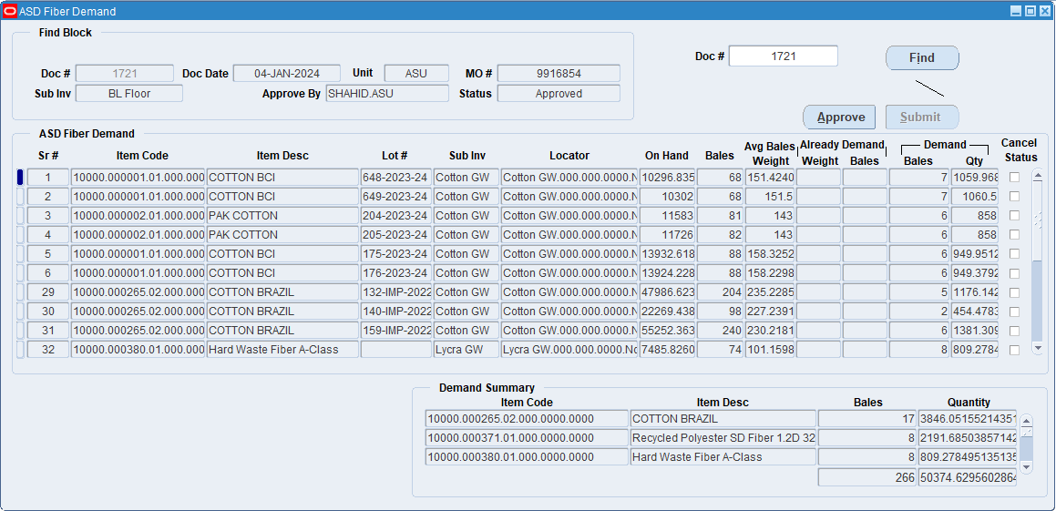
Responsibility Name : ASD Uster Testing Results Form Name : ASD Fiber Demand Demand Note for Issuance of Bales For issuance, FIBER Demand FORM will be filled out to raised demand to issue bales. Following form is available to raise demand in system. Only tested bales data will be populated in below form. User will mark the bales in demand form for issuance.

Slide 31
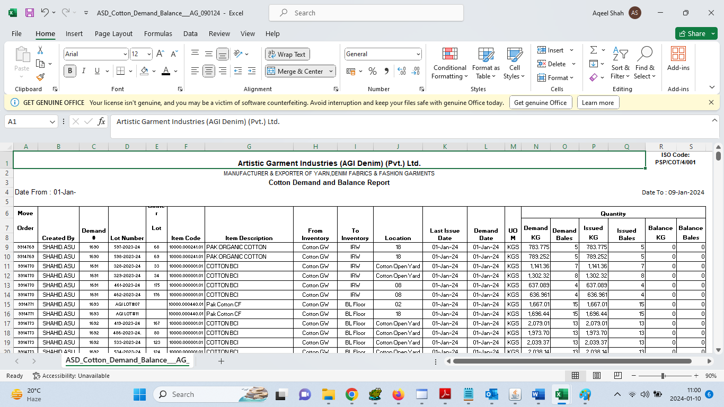
Report Name : ASD Cotton Demand Balance - AGI - Report

Slide 32
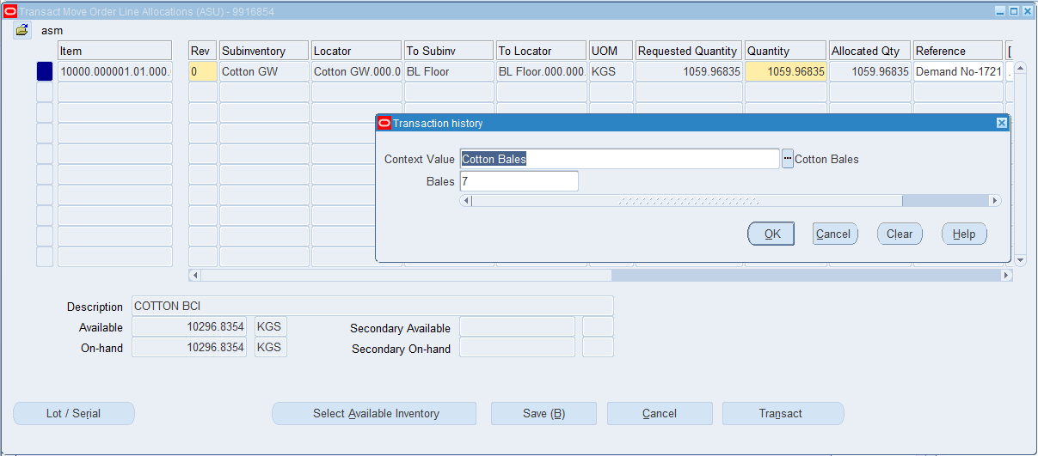
Responsibility Name : ASD Inventory Team Member
Form Name : Transact Move Order
Auto Issuance of Bales against Demand Note
Store department will select demand number and will press Issue Button, this will issue bales for Production as per requested quantity. Multiple Demand Notes can be issued in one-go.

Slide 33
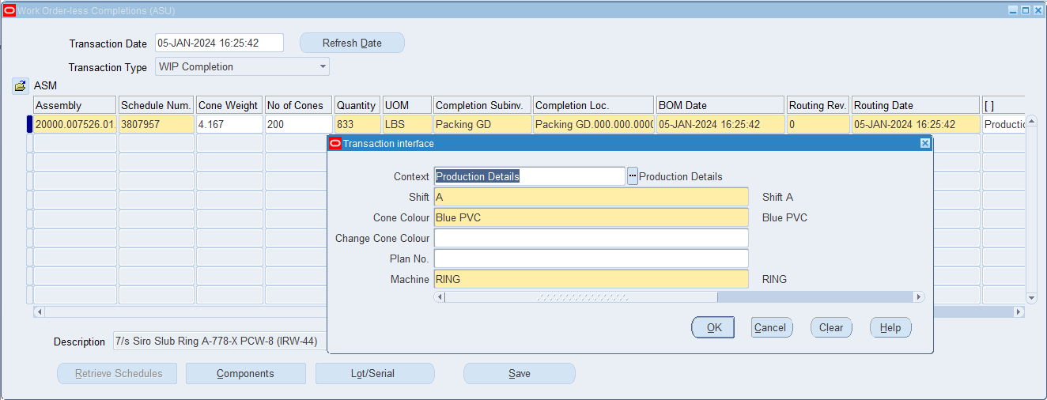
Responsibility Name : ASD Work In Process Form Name : Work Order-Less Completion Production : Daily production of yarn is entered at final stage by using work order less completion form against the production plan provided by planning team.

Slide 34
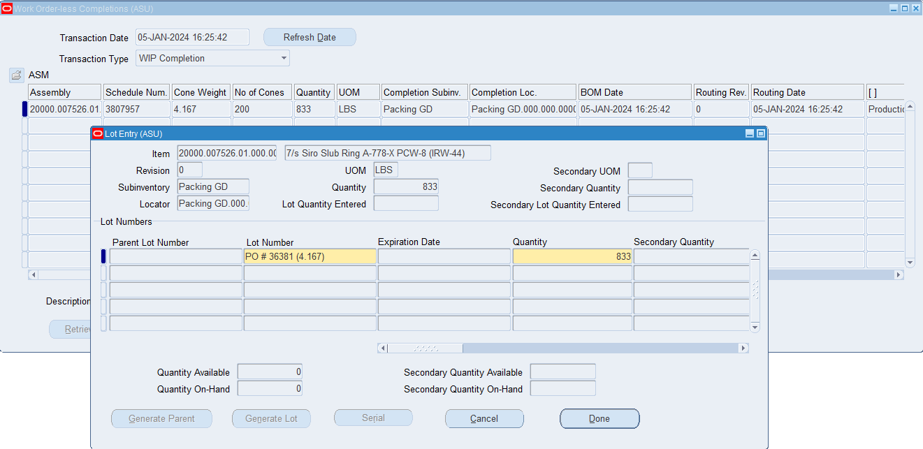
Responsibility Name : ASD Work In Process Form Name : Work Order-Less Completion The plan number field is connected to yarn item being produced. User can only select those plans which are updated by planning department against select yarn item. All raw materials which are defined in BOM are automatically charged on the basis of set standards upon performing work order less completion transaction

Slide 35
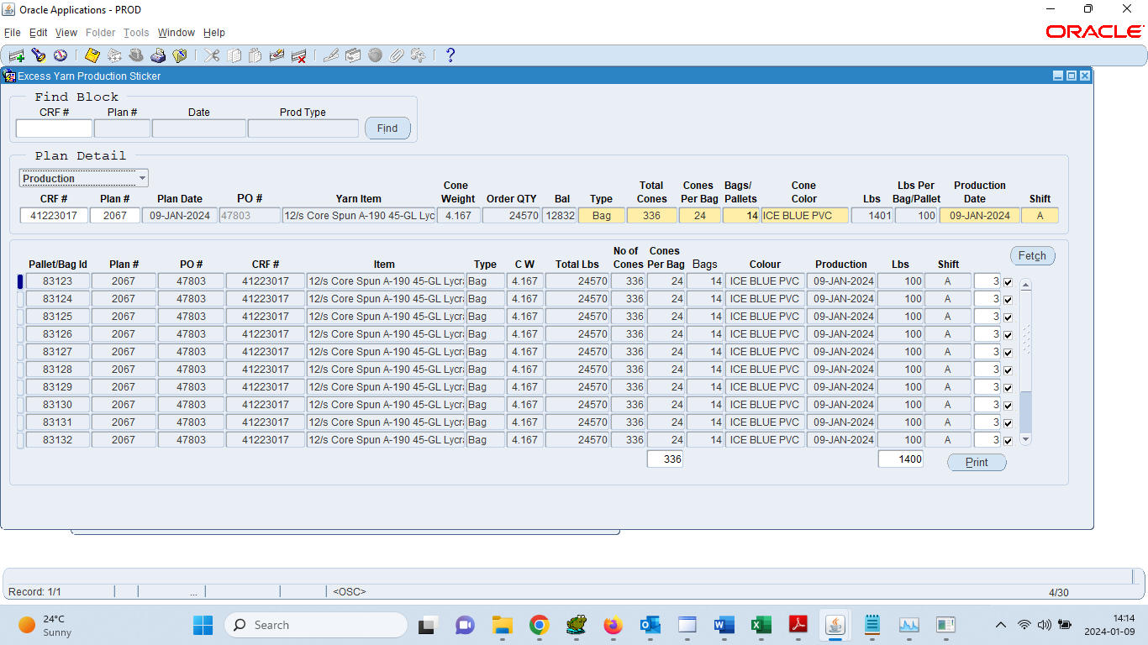
Responsibility Name : ASD Work In Process Form Name : ASD Yarn Sticker Special Information: I wanted to inform you about the upcoming upgrade for our production system. The new system will replace the workorder less form and comes with the added functionality of generating stickers based on the planned quantity. This enhancement aims to streamline our processes and improve overall efficiency.

Slide 36
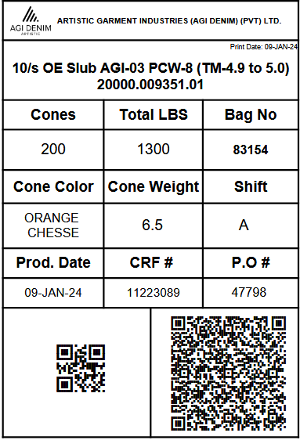
Sticker Report:
This sticker QR code have information
according this sticker.
User can scan
and get information.

Slide 37
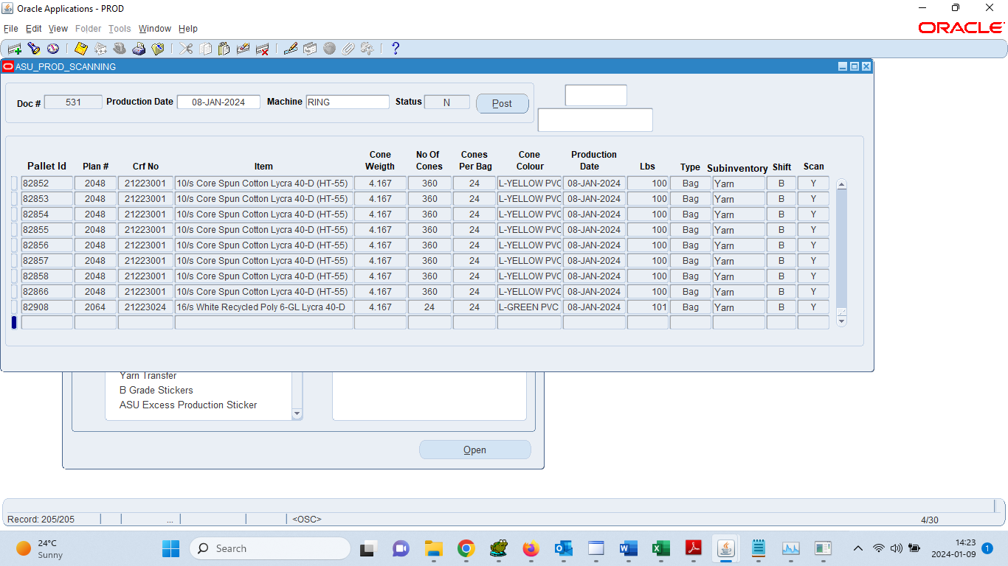
Production (New Form) Responsibility Name : ASD Work In Process Form Name : ASD Production Scan

Slide 38
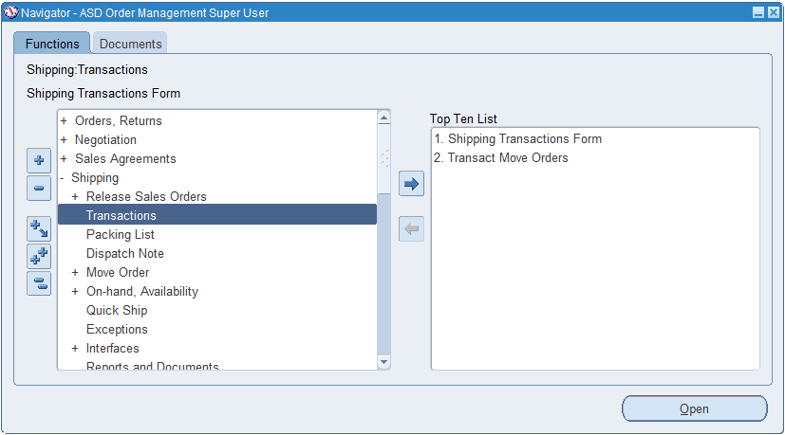
Responsibility Name : ASD Order Management Super User Dispatch Standard dispatch form will be available to user for shipment. Account for Dispatch: At sales order shipment, order lines are costed and booked to a Deferred Cost of Goods Sold (COGS) account. This account is subsequently adjusted for any change in the percentage of earned or recognized revenue associated with the sales order lines.

Slide 39
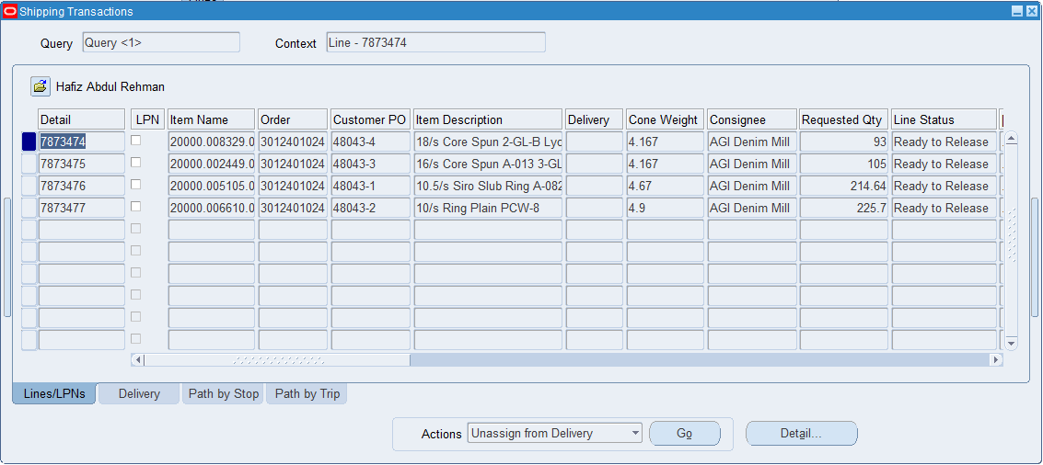
Responsibility Name : ASD Order Management Super User Form Name : Shipping Transactions Dispatch Lines detail :

Slide 40
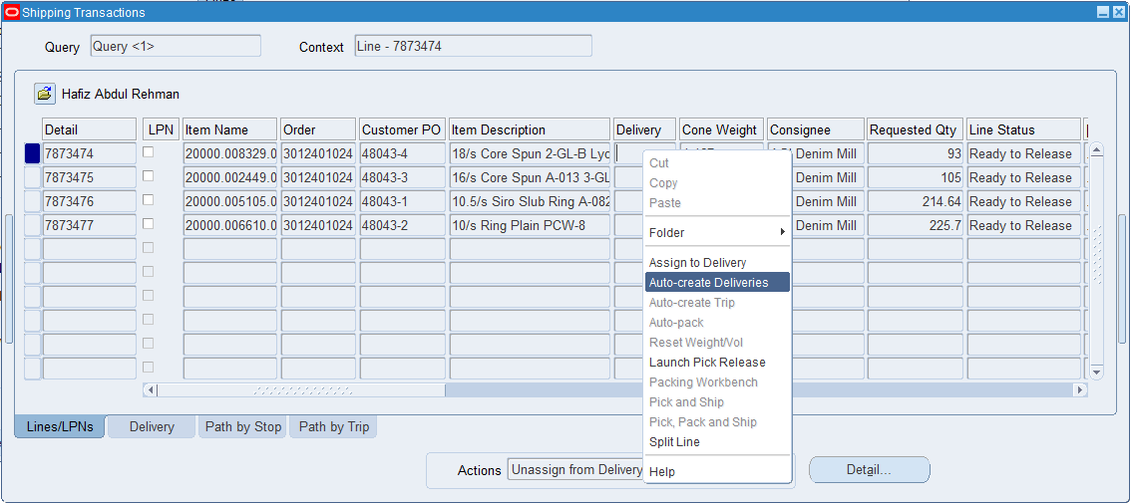
Responsibility Name : ASD Order Management Super User Form Name : Shipping Transactions Dispatch: Select item which you want to dispatch. Assign delivery number by using auto create delivery and perform pick release activity from action block.

Slide 41
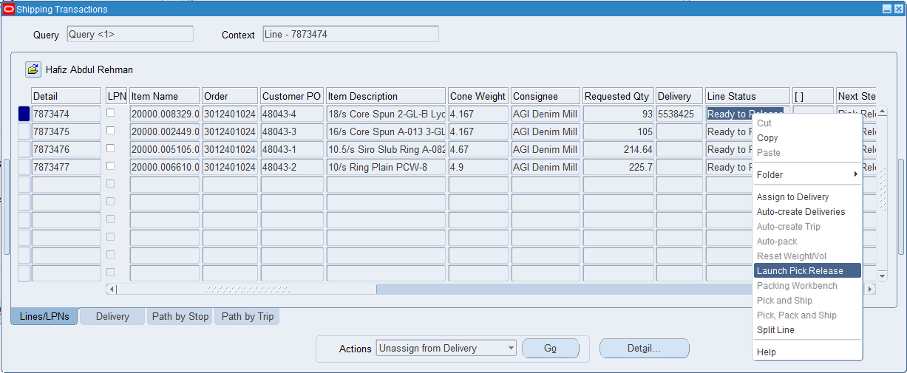
Responsibility Name : ASD Order Management Super User Form Name : Shipping Transactions Dispatch: Launch pick release

Slide 42
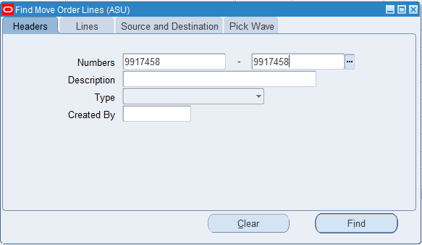
Responsibility Name : ASD Order Management Super User Form Name : Transact Move Order Dispatch: Once order line is released, Goto mover order transact form and allocate stock which you want to dispatch against this line.

Slide 43
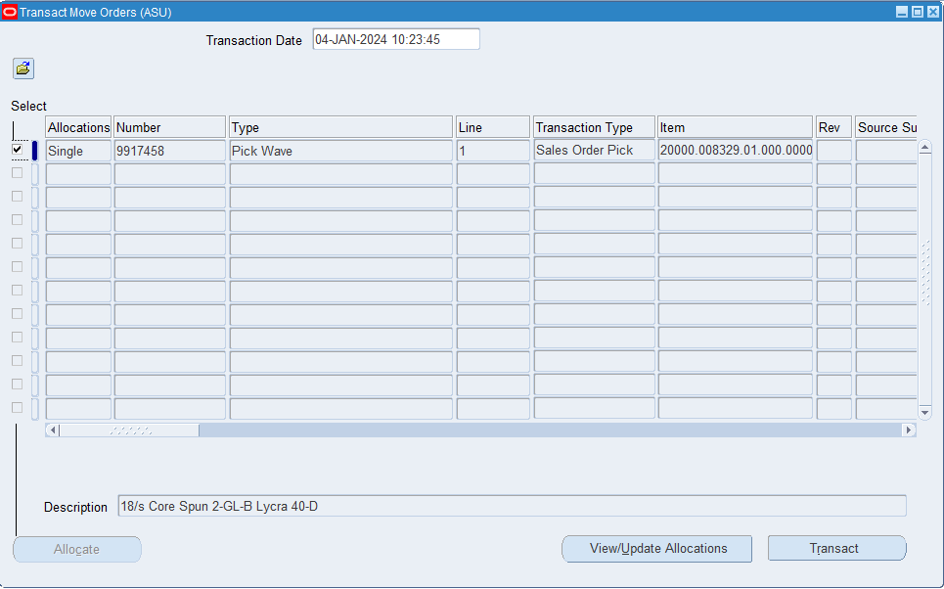
Responsibility Name : ASD Order Management Super User Form Name : Transact Move Order Dispatch: Allocate stock and the press view/Update Allocations button to select relevant lot and cone weight against order line.

Slide 44
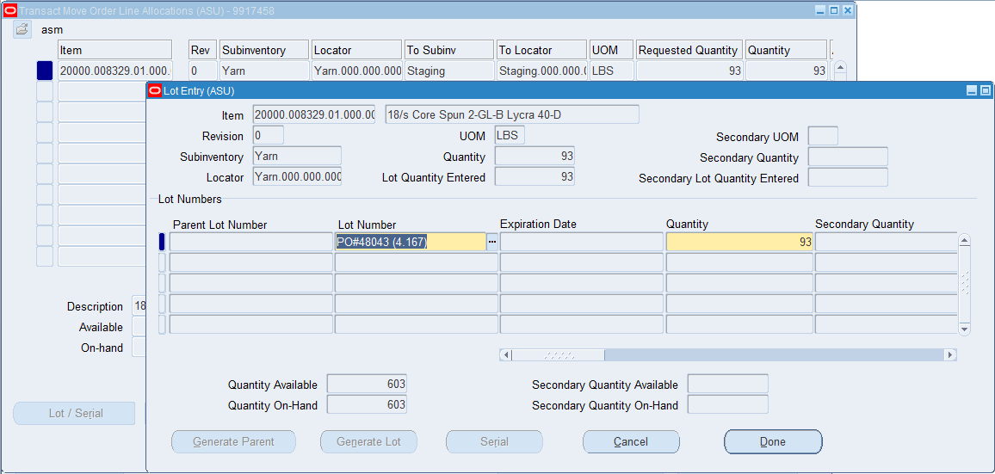
Responsibility Name : ASD Order Management Super User Form Name : Transact Move Order Lot Entry Dispatch:

Slide 45
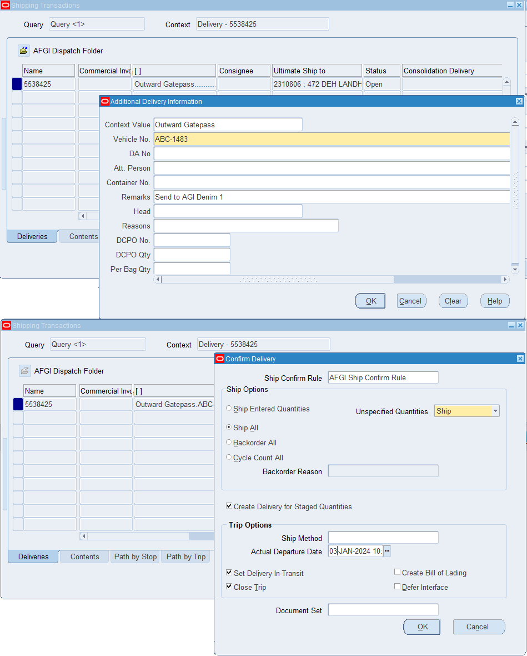
Responsibility Name : ASD Order Management Super User Form Name : Shipping Transactions Dispatch: Once stock is allocated and transacted, go to shipping transaction form and dispatch your delivery.

Slide 46
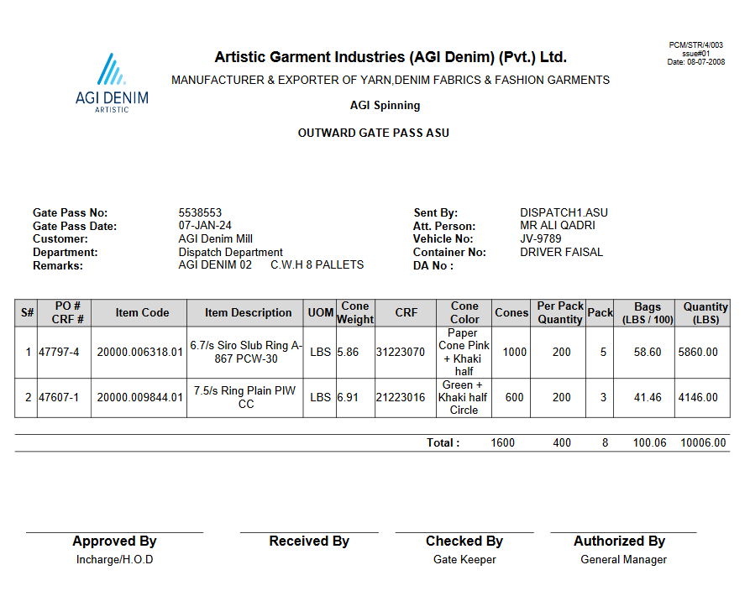
Report Name : ASD Yarn OGP- AGI (Denim) - Report Automated gate pass will be generated in system once order line is shipped. Outward Gate Pass

Slide 47
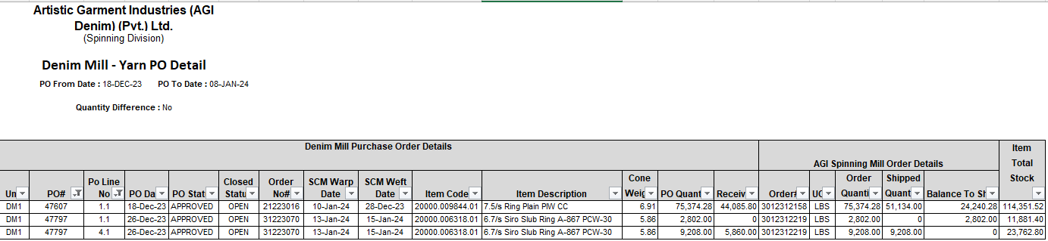
Responsibility Name : ASD Order Management Super User
Report Name : Denim Mill - Yarn PO Detail for Spinning Mill - AGI (Denim) - Report

Slide 48
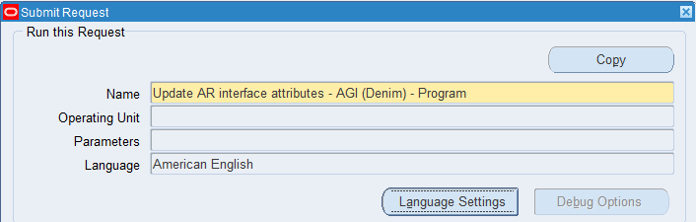
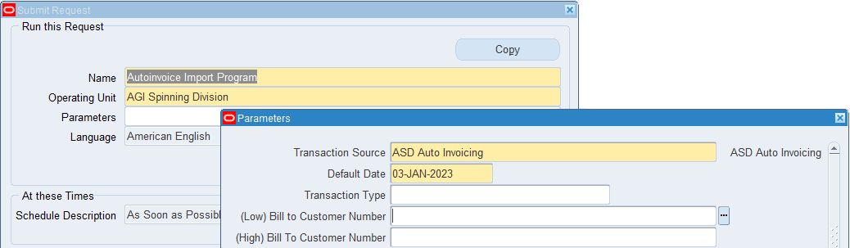
Responsibility Name : ASD Receivable Manager – ASD Invoicing Automated program will be schedule on daily basis to generated auto invoices from dispatch transactions.

Slide 49
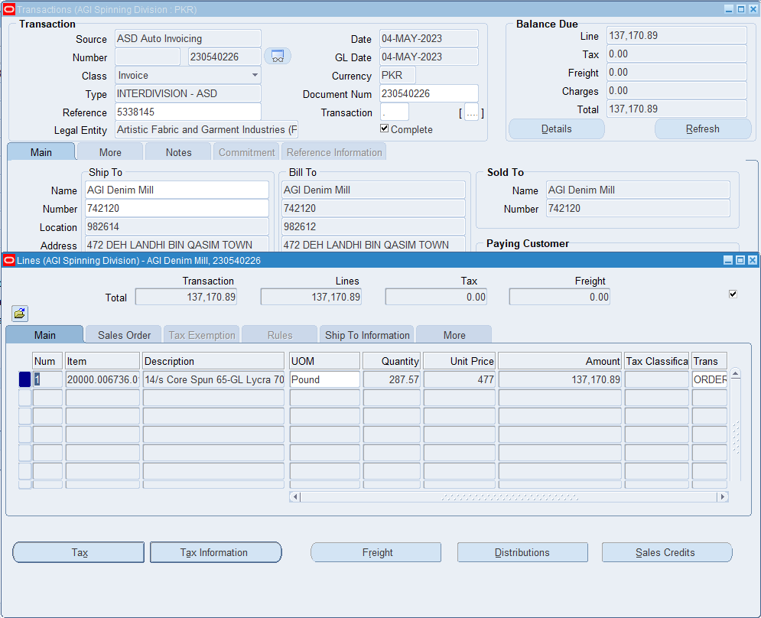
Responsibility Name : ASD Receivable Manager – ASD Form Name : Receivable Invoice Transactions

Slide 50
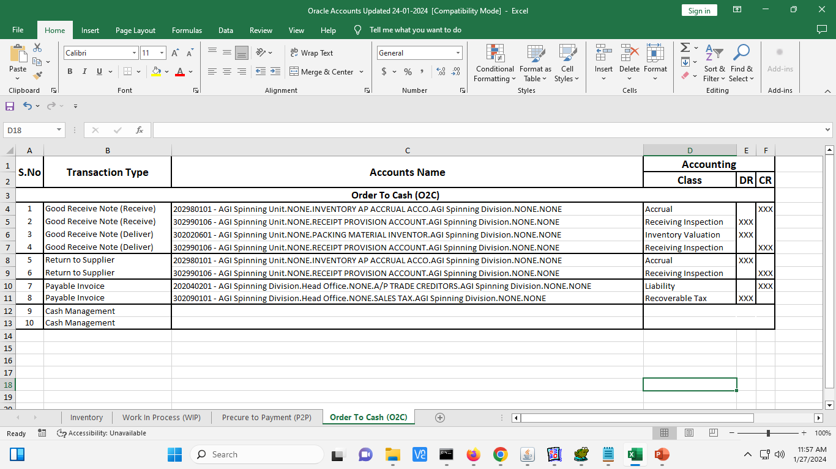
Overview
Following are major accounting events of AGI Spinning Mill

Slide 51
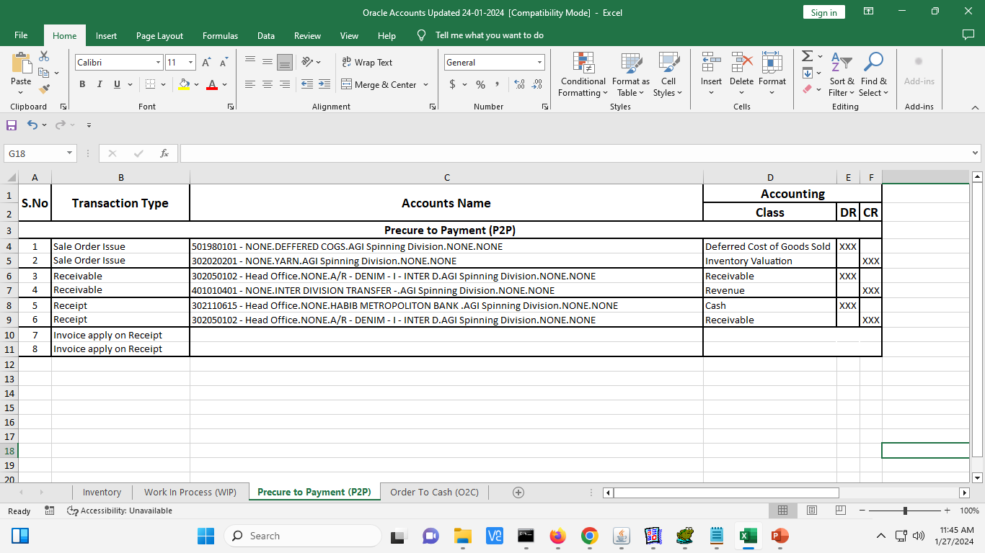
Overview
Following are major accounting events of AGI Spinning Mill

Slide 52
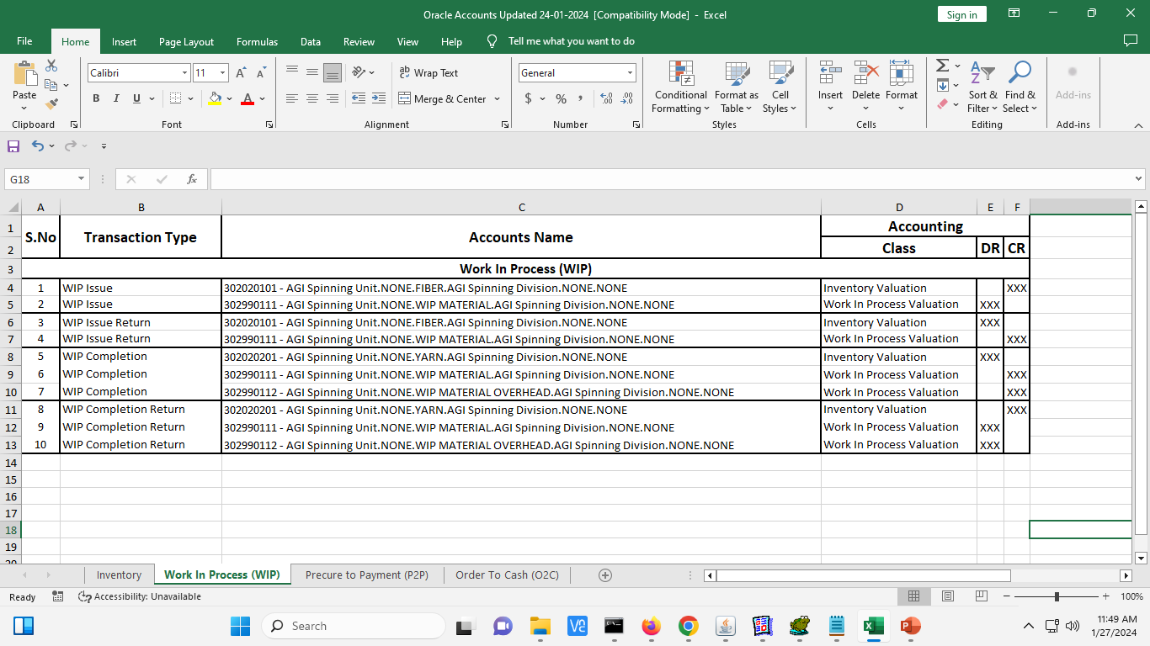
Overview
Following are major accounting events of AGI Spinning Mill

Slide 53
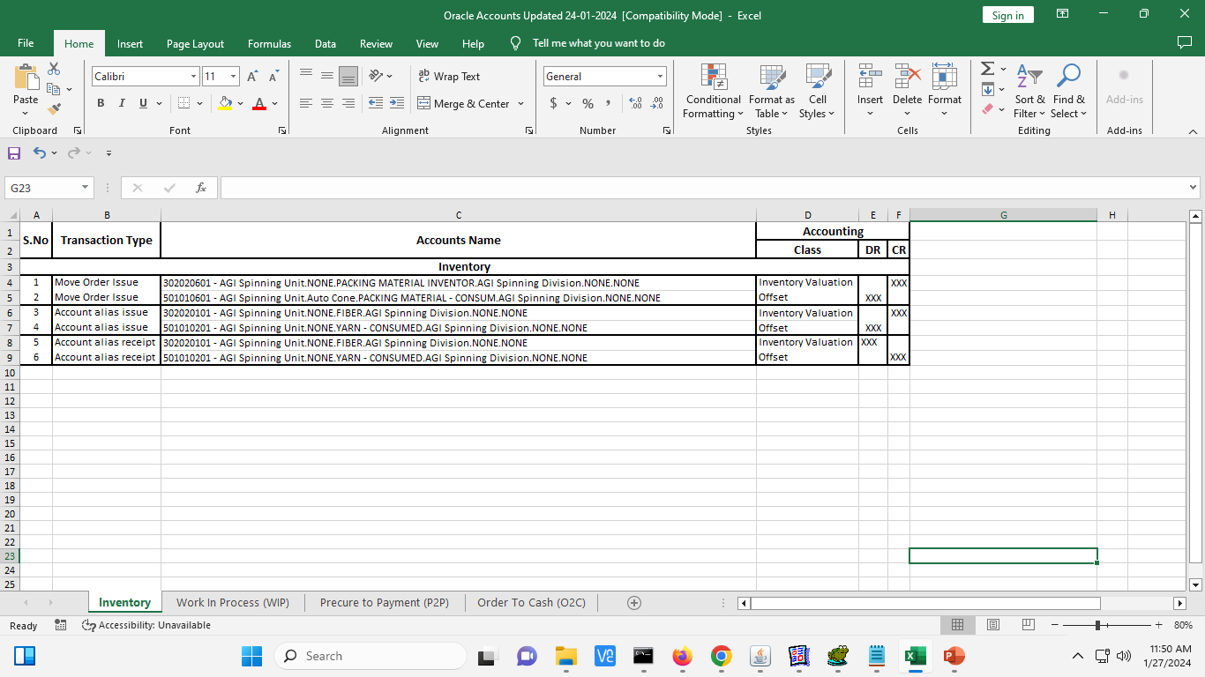
Overview
Following are major accounting events of AGI Spinning Mill

Slide 54


